Slide 1
BBM-382 – SOFTWARE ENGINEERING
SPRING 2017
Lecture 13 – May.16th 2017
Assoc.Prof.Dr. Vahid GAROUSI
Asst.Prof.Dr. Ayça TARHAN

Slide 2
Plan-driven and agile processes
Plan-driven processes are processes where all of the process activities are planned in advance and progress is measured against this plan.
In agile processes, planning is incremental and it is easier to change the process to reflect changing customer requirements.
As Boehm and Turner (2003) discuss, each approach is suitable for different types of software.
In practice, most practical processes include elements of both plan-driven and agile approaches.
There are no right or wrong software processes – they are tailored according to specific needs of software development.

Slide 3
2.1 Software Process Models

Slide 4
Software Process Models
The waterfall model
Plan-driven model.
Separate and distinct phases of specification and development.
Incremental development
Specification, development and validation are interleaved.
May be plan-driven or agile.
Reuse-oriented software engineering
The system is assembled from existing components.
May be plan-driven or agile.

Slide 5
Software Process Models (..continued)
The waterfall model
Plan-driven model. / This approach takes the fundamental process activities of specification, development, validation, and evolution, and represents them as separate process phases in sequence.
Incremental development
May be plan-driven or agile. / This approach interleaves the activities of specification, development, and validation. The system is developed as a series of versions (increments), with each version adding functionality to the previous version.
Reuse-oriented software engineering
May be plan-driven or agile. / This approach is based on the existence of a significant number of reusable components. The system development process focuses on integrating these components into a system rather than developing them from scratch.
Already covered in Week#1

Slide 6
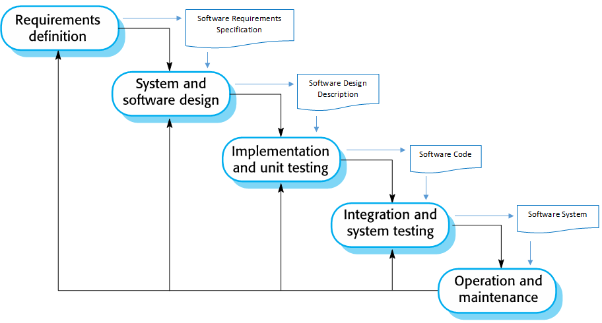
1. Waterfall Model (Re-visited)

Slide 7
The Waterfall Model - Benefits
The waterfall model is consistent with other engineering process models.
Documentation is produced at each phase.
This makes the process visible so managers can monitor progress against the development plan.
As is easier to use a common management model in other engineering projects for the whole project, software processes based on the waterfall model are still commonly used.

Slide 8
Waterfall Model - Problems
It is difficult to accommodate change after the process is underway.
A phase has to be complete before moving onto the next phase.
Inflexible partitioning of the project into distinct stages makes it difficult to respond to changing customer requirements.
Few business systems have stable requirements.
For the majority of systems this model does not offer significant cost-benefits over other approaches to system development.

Slide 9
Waterfall Model - Usage
In principle, the waterfall model should only be used when the requirements are well understood and unlikely to change radically during system development.
The waterfall model is mostly used for large systems engineering projects where a system is developed at several sites.
In those circumstances, the plan-driven nature of the waterfall model helps coordinate the work.

Slide 10
2. Incremental Development
Incremental Development is based on the idea of developing an initial implementation, exposing this to user comment and evolving it through several versions until an adequate system has been developed.

Slide 11
Incremental Development
Incremental software development, which is a fundamental part of agile approaches, is better than a waterfall approach for most business, e-commerce, and personal systems.
Incremental development reflects the way that we solve problems.
We rarely work out a complete problem solution in advance but move toward a solution in a series of steps, backtracking when we realize that we have made a mistake.
By developing the software incrementally, it is cheaper and easier to make changes in the software as it is being developed.

Slide 12
Incremental Development
Each increment or version of the system incorporates some of the functionality that is needed by the customer.
Generally, the early increments of the system include the most important or most urgently required functionality.
This means that the customer can evaluate the system at a relatively early stage in the development to see if it delivers what is required.
If not, then only the current increment has to be changed and, possibly, new functionality defined for later increments.

Slide 13
Incremental Development
Incremental development in some form is now the most common approach for the development of application systems.
This approach can be either plan-driven, agile, or, more usually, a mixture of these approaches.
In a plan-driven approach, the system increments are identified in advance;
If an agile approach is adopted, the early increments are identified but the development of later increments depends on progress and customer priorities.

Slide 14
Incremental Development - Benefits
The cost of accommodating changing customer requirements is reduced.
The amount of analysis and documentation that has to be redone is much less than is required with the waterfall model.
It is easier to get customer feedback on the development work that has been done.
Customers can comment on demonstrations of the software and see how much has been implemented.
More rapid delivery and deployment of useful software to the customer is possible.
Customers are able to use and gain value from the software earlier than is possible with a waterfall process.

Slide 15
Incremental Development - Problems
The process is not visible. Managers need regular deliverables to measure progress. If systems are developed quickly, it is not cost-effective to produce documents that reflect every version of the system.
System structure tends to degrade as new increments are added. Unless time and money is spent on refactoring to improve the software, regular change tends to corrupt its structure. Incorporating further software changes becomes increasingly difficult and costly.

Slide 16
Incremental Development - Usage
The problems of incremental development become particularly acute for large, complex, long-lifetime systems, where different teams develop different parts of the system.
Large systems need a stable framework or architecture and the responsibilities of the different teams working on parts of the system need to be clearly defined with respect to that architecture.
This has to be planned in advance rather than developed incrementally.

Slide 17
3. Reuse-Oriented Software Engineering
In the majority of software projects, there is some software reuse.
This often happens informally when people working on the project know of designs or code that are similar to what is required. They look for these, modify them as needed, and incorporate them into their system.
This informal reuse takes place irrespective of the development process that is used.

Slide 18
Reuse-Oriented Software Engineering (ROSE)
In the 21st century, software development processes that focus on the reuse of existing software have become widely used.
Reuse-oriented approaches rely on a large base of reusable software components and an integrating framework for the composition of these components.
Sometimes, these components are systems in their own right (COTS or commercial off-the-shelf systems) that may provide specific functionality such as word processing or a spreadsheet.
Notes:
Reuse is now the standard approach for building many types of business systems.

Slide 19
Reuse-Oriented Software Engineering
Although the initial requirements specification stage and the validation stage are comparable with other software processes, the intermediate stages in a reuse-oriented process are different:
Component analysis;
Requirements modification;
System design with reuse;
Development and integration.

Slide 20


Example: Reusability

Slide 21
Types of Software Components
There are three types of software components that may be used in a reuse-oriented process:
Web services that are developed according to service standards and which are available for remote invocation.
Collections of objects that are developed as a package to be integrated with a component framework such as .NET or J2EE.
Stand-alone software systems that are configured for use in a particular environment.

Slide 22
ROSE – Benefits & Problems
Benefits
Reuse-oriented software engineering has the obvious advantage of reducing the amount of software to be developed and so reducing cost and risks.
It usually also leads to faster delivery of the software.
Problems
However, requirements compromises are inevitable and this may lead to a system that does not meet the real needs of users.
Furthermore, some control over the system evolution is lost as new versions of the reusable components are not under the control of the organization using them.

Slide 23
2.3 CopIng with Change

Slide 24
Coping with change
Change is inevitable in all large software projects.
Business changes lead to new and changed system requirements.
New technologies open up new possibilities for improving implementations.
Changing platforms require application changes.
Change leads to rework so the costs of change include both rework (e.g. re-analyzing requirements) as well as the costs of implementing new functionality.

Slide 25
Reducing the costs of rework
Change avoidance, where the software process includes activities that can anticipate possible changes before significant rework is required.
For example, a prototype system may be developed to show some key features of the system to customers.
Change tolerance, where the process is designed so that changes can be accommodated at relatively low cost.
This normally involves some form of incremental development.
Notes:
Proposed changes may be implemented in increments that have not yet been developed. If this is impossible, then only a single increment (a small part of the system) may have be altered to incorporate the change.

Slide 26
1. Software prototyping
A prototype is an initial version of a system used to demonstrate concepts and try out design options.
May be based on rapid prototyping languages or tools.
A prototype can be used in:
The requirements engineering process to help with requirements elicitation and validation;
In design processes to explore options and develop a user interface (UI) design;
In the testing process to run back-to-back tests.

Slide 27
Benefits of prototyping
Improved system usability.
A closer match to users’ real needs.
Improved design quality.
Improved maintainability.
Reduced development effort.

Slide 28
The process of prototype development
May involve leaving out functionality
Prototype should focus on areas of the product that are not well-understood
Error checking and recovery may not be included in the prototype
Focus on functional rather than non-functional requirements such as reliability and security

Slide 29
Throw-away prototypes
Prototypes should be discarded after development as they are not a good basis for a production system:
It may be impossible to tune the system to meet non-functional requirements
Prototypes are normally undocumented
The prototype structure is usually degraded through rapid change
The prototype probably will not meet normal organizational quality standards

Slide 30
2. Incremental delivery
Rather than delivering the system as a single delivery, the development and delivery is broken down into increments with each increment delivering part of the required functionality.
User requirements are prioritised and the highest priority requirements are included in early increments.
Once the development of an increment is started, the requirements are frozen though requirements for later increments can continue to evolve.

Slide 31
Incremental development and delivery
Incremental development
Develop the system in increments and evaluate each increment before proceeding to the development of the next increment
Normal approach used in agile methods
Evaluation done by user/customer proxy
Incremental delivery
Deploy an increment for use by end-users
More realistic evaluation about practical use of software
Difficult to implement for replacement systems as increments have less functionality than the system being replaced

Slide 32
Incremental delivery

Slide 33
Incremental delivery - Benefits
Customer value can be delivered with each increment so system functionality is available earlier.
Early increments act as a prototype to help elicit requirements for later increments.
Lower risk of overall project failure.
The highest priority system services tend to receive the most testing.

Slide 34
Incremental delivery - Problems
Most systems require a set of basic facilities that are used by different parts of the system.
As requirements are not defined in detail until an increment is to be implemented, it can be hard to identify common facilities that are needed by all increments.
The essence of iterative processes is that the specification is developed in conjunction with the software.
However, this conflicts with the procurement model of many organizations, where the complete system specification is part of the system development contract.

Slide 35
3. Boehm’s spiral model
Process is represented as a spiral rather than as a sequence of activities with backtracking.
Each loop in the spiral represents a phase in the process.
No fixed phases such as specification or design - loops in the spiral are chosen depending on what is required.
Risks are explicitly assessed and resolved throughout the process.

Slide 36
Boehm’s spiral model of the software process

Slide 37
Spiral model sectors
Objective setting
Specific objectives for the phase are identified.
Risk assessment and reduction
Risks are assessed and activities put in place to reduce the key risks.
Development and validation
A development model for the system is chosen which can be any of the generic models.
Planning
The project is reviewed and the next phase of the spiral is planned.

Slide 38
Spiral model - Usage
Spiral model has been very influential in helping people think about iteration in software processes and introducing the risk-driven approach to development.
In practice, however, the model is rarely used as published for practical software development.

Slide 39
4. The Rational Unified Process (RUP)
A modern generic process derived from the work on the UML (Unified Modeling Language) and associated process.
Brings together aspects of the 3 generic process models discussed previously.
Normally described from 3 perspectives:
A dynamic perspective that shows phases over time
A static perspective that shows process activities
A practice perspective that suggests good practice.

Slide 40
RUP phases
Inception
Establish the business case for the system.
Elaboration
Develop an understanding of the problem domain and the system architecture.
Construction
System design, programming and testing.
Transition
Deploy the system in its operating environment.

Slide 41
RUP iteration
In-phase iteration
Each phase is iterative with results developed incrementally.
Cross-phase iteration
As shown by the loop in the RUP model, the whole set of phases may be enacted incrementally.

Slide 42
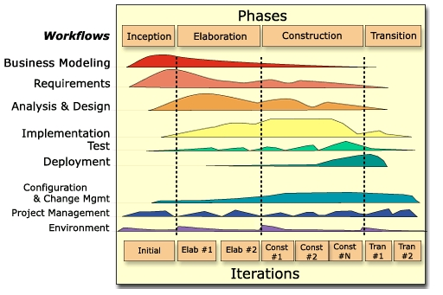
RUP – Workflows, Phases, and Iterations

Slide 43
3. AGILE SOFTWARE DEVELOPMENT

Slide 44
Agile Methods
Dissatisfaction with the overheads involved in software design methods of the 1980s and 1990s led to the creation of agile methods. These methods:
Focus on the code rather than the design
Are based on an iterative approach to software development
Are intended to deliver working software quickly and evolve this quickly to meet changing requirements.
The aim of agile methods is to reduce overheads in the software process (e.g. by limiting documentation) and to be able to respond quickly to changing requirements without excessive rework.

Slide 45
Agile Manifesto
We are uncovering better ways of developing software by doing it and helping others do it. Through this work we have come to value:
Individuals and interactions over processes and tools
Working software over comprehensive documentation
Customer collaboration over contract negotiation
Responding to change over following a plan
That is, while there is value in the items on the right, we value the items on the left more.

Slide 46
Principles of Agile Methods
Principle | Description
Customer involvement | Customers should be closely involved throughout the development process. Their role is provide and prioritize new system requirements and to evaluate the iterations of the system.
Incremental delivery | The software is developed in increments with the customer specifying the requirements to be included in each increment.
People not process | The skills of the development team should be recognized and exploited. Team members should be left to develop their own ways of working without prescriptive processes.
Embrace change | Expect the system requirements to change and so design the system to accommodate these changes.
Maintain simplicity | Focus on simplicity in both the software being developed and in the development process. Wherever possible, actively work to eliminate complexity from the system.

Slide 47
Plan-driven and agile development
Plan-driven development
A plan-driven approach to software engineering is based around separate development stages with the outputs to be produced at each of these stages planned in advance.
Not necessarily waterfall model – plan-driven, incremental development is possible
Iteration occurs within activities.
Agile development
Specification, design, implementation and testing are inter-leaved and the outputs from the development process are decided through a process of negotiation during the software development process.

Slide 48
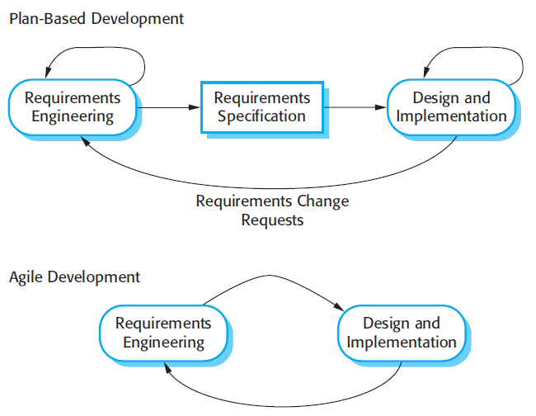
Plan-driven and agile specification

Slide 49
Extreme programming
Perhaps the best-known and most widely used agile method.
Extreme Programming (XP) takes an ‘extreme’ approach to iterative development.
New versions may be built several times per day;
Increments are delivered to customers every 2 weeks;
All tests must be run for every build and the build is only accepted if tests run successfully.

Slide 50
XP and agile principles
Incremental development is supported through small, frequent system releases.
Customer involvement means full-time customer engagement with the team.
People not process through pair programming, collective ownership and a process that avoids long working hours.
Change supported through regular system releases.
Maintaining simplicity through constant refactoring of code.

Slide 51
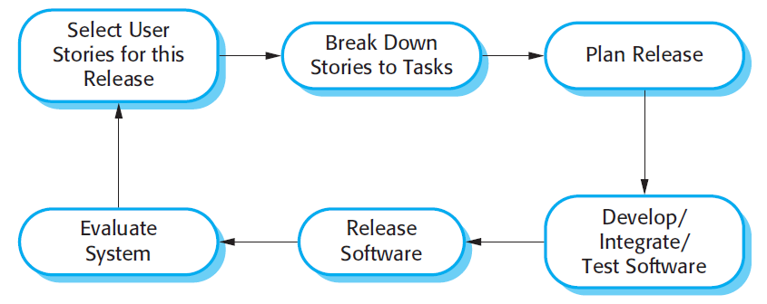
The extreme programming release cycle

Slide 52
Extreme programming practices (1)
Principle or practice | Description
Incremental planning | Requirements are recorded on story cards and the stories to be included in a release are determined by the time available and their relative priority. The developers break these stories into development ‘Tasks’. See Figures 3.5 and 3.6.
Small releases | The minimal useful set of functionality that provides business value is developed first. Releases of the system are frequent and incrementally add functionality to the first release.
Simple design | Enough design is carried out to meet the current requirements and no more.
Test-first development | An automated unit test framework is used to write tests for a new piece of functionality before that functionality itself is implemented.
Refactoring | All developers are expected to refactor the code continuously as soon as possible code improvements are found. This keeps the code simple and maintainable.

Slide 53
Extreme programming practices (2)
Pair programming | Developers work in pairs, checking each other’s work and providing the support to always do a good job.
Collective ownership | The pairs of developers work on all areas of the system, so that no islands of expertise develop and all the developers take responsibility for all of the code. Anyone can change anything.
Continuous integration | As soon as the work on a task is complete, it is integrated into the whole system. After any such integration, all the unit tests in the system must pass.
Sustainable pace | Large amounts of overtime are not considered acceptable as the net effect is often to reduce code quality and medium term productivity
On-site customer | A representative of the end-user of the system (the customer) should be available full time for the use of the XP team. In an extreme programming process, the customer is a member of the development team and is responsible for bringing system requirements to the team for implementation.

Slide 54
XP and Change
Conventional wisdom in software engineering is to design for change. It is worth spending time and effort anticipating changes as this reduces costs later in the life cycle.
XP, however, maintains that this is not worthwhile as changes cannot be reliably anticipated.
Rather, it proposes constant code improvement (refactoring) to make changes easier when they have to be implemented.

Slide 55
Refactoring
Programming team look for possible software improvements and make these improvements even where there is no immediate need for them.
Examples:
Re-organization of a class hierarchy to remove duplicate code.
Tidying up and renaming attributes and methods to make them easier to understand.
The replacement of inline code with calls to methods that have been included in a program library.

Slide 56
Agile Project Management
The principal responsibility of software project managers is to manage the project so that the software is delivered on time and within the planned budget for the project.
The standard approach to project management is plan-driven. Managers draw up a plan for the project showing what should be delivered, when it should be delivered and who will work on the development of the project deliverables.
Agile project management requires a different approach, which is adapted to incremental development and the particular strengths of agile methods.

Slide 57
Scrum
The Scrum approach is a general agile method but its focus is on managing iterative development rather than specific agile practices.
There are three phases in Scrum.
The initial phase is an outline planning phase where you establish the general objectives for the project and design the software architecture.
This is followed by a series of sprint cycles, where each cycle develops an increment of the system.
The project closure phase wraps up the project, completes required documentation such as system help frames and user manuals and assesses the lessons learned from the project.

Slide 58
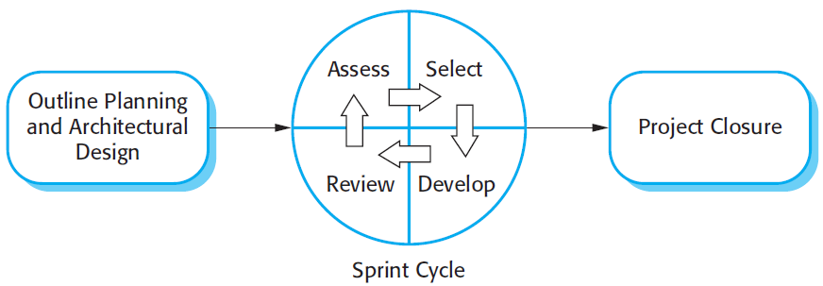
Scrum Process

Slide 59
The Sprint Cycle
Sprints are fixed length, normally 2–4 weeks. They correspond to the development of a release of the system in XP.
The starting point for planning is the product backlog, which is the list of work to be done on the project.
The selection phase involves all of the project team who work with the customer to select the features and functionality to be developed during the sprint.

Slide 60
The Sprint Cycle
Once these are agreed, the team organize themselves to develop the software. During this stage the team is isolated from the customer and the organization, with all communications channelled through the so-called ‘Scrum master’.
The role of the Scrum master is to protect the development team from external distractions.
At the end of the sprint, the work done is reviewed and presented to stakeholders. The next sprint cycle then begins.

Slide 61
Teamwork in Scrum
The ‘Scrum master’ is a facilitator who arranges daily meetings, tracks the backlog of work to be done, records decisions, measures progress against the backlog and communicates with customers and management outside of the team.
The whole team attends short daily meetings where all team members share information, describe their progress since the last meeting, problems that have arisen and what is planned for the following day.
This means that everyone on the team knows what is going on and, if problems arise, can re-plan short-term work to cope with them.

Slide 62
Scrum Benefits
The product is broken down into a set of manageable and understandable chunks.
Unstable requirements do not hold up progress.
The whole team have visibility of everything and consequently team communication is improved.
Customers see on-time delivery of increments and gain feedback on how the product works.
Trust between customers and developers is established and a positive culture is created in which everyone expects the project to succeed.

Slide 63
For student reVIEW…

Slide 64
ROSE - Stages
Component analysis Given the requirements specification, a search is made for components to implement that specification. Usually, there is no exact match and the components that may be used only provide some of the functionality required.
Requirements modification During this stage, the requirements are analyzed using information about the components that have been discovered. They are then modified to reflect the available components. Where modifications are impossible, the component analysis activity may be re-entered to search for alternative solutions.
System design with reuse
Development and integration

Slide 65
ROSE - Stages
Component analysis
Requirements modification
System design with reuse During this phase, the framework of the system is designed or an existing framework is reused. The designers take into account the components that are reused and organize the framework to cater for this. Some new software may have to be designed if reusable components are not available.
Development and integration Software that cannot be externally procured is developed, and the components and COTS systems are integrated to create the new system. System integration, in this model, may be part of the development process rather than a separate activity.

Slide 66
Static workflows in RUP
Workflow | Description
Business modelling | The business processes are modelled using business use cases.
Requirements | Actors who interact with the system are identified and use cases are developed to model the system requirements.
Analysis and design | A design model is created and documented using architectural models, component models, object models and sequence models.
Implementation | The components in the system are implemented and structured into implementation sub-systems. Automatic code generation from design models helps accelerate this process.

Slide 67
Static workflows in RUP
Workflow | Description
Testing | Testing is an iterative process that is carried out in conjunction with implementation. System testing follows the completion of the implementation.
Deployment | A product release is created, distributed to users and installed in their workplace.
Configuration and change management | This supporting workflow managed changes to the system.
Project management | This supporting workflow manages the system development.
Environment | This workflow is concerned with making appropriate software tools available to the software development team.

Slide 68
RUP good practices
Develop software iteratively
Plan increments based on customer priorities and deliver highest priority increments first.
Manage requirements
Explicitly document customer requirements and keep track of changes to these requirements.
Use component-based architectures
Organize the system architecture as a set of reusable components.

Slide 69
RUP good practices
Visually model software
Use graphical UML models to present static and dynamic views of the software.
Verify software quality
Ensure that the software meet’s organizational quality standards.
Control changes to software
Manage software changes using a change management system and configuration management tools.

Slide 70
Key points
Processes should include activities to cope with change. This may involve a prototyping phase that helps avoid poor decisions on requirements and design.
Processes may be structured for iterative development and delivery so that changes may be made without disrupting the system as a whole.
The Rational Unified Process is a modern generic process model that is organized into phases (inception, elaboration, construction and transition) but separates activities (requirements, analysis and design, etc.) from these phases.

Slide 71
Agile method applicability
Product development where a software company is developing a small or medium-sized product for sale.
Custom system development within an organization, where there is a clear commitment from the customer to become involved in the development process and where there are not a lot of external rules and regulations that affect the software.
Because of their focus on small, tightly-integrated teams, there are problems in scaling agile methods to large systems.

Slide 72
Problems with agile methods
It can be difficult to keep the interest of customers who are involved in the process.
Team members may be unsuited to the intense involvement that characterises agile methods.
Prioritising changes can be difficult where there are multiple stakeholders.
Maintaining simplicity requires extra work.
Contracts may be a problem as with other approaches to iterative development.

Slide 73
Agile methods and software maintenance
Most organizations spend more on maintaining existing software than they do on new software development. So, if agile methods are to be successful, they have to support maintenance as well as original development.
Two key issues:
Are systems that are developed using an agile approach maintainable, given the emphasis in the development process of minimizing formal documentation?
Can agile methods be used effectively for evolving a system in response to customer change requests?
Problems may arise if original development team cannot be maintained.

Slide 74
XP - Requirements Scenarios
In XP, a customer or user is part of the XP team and is responsible for making decisions on requirements.
User requirements are expressed as scenarios or user stories.
These are written on cards and the development team break them down into implementation tasks. These tasks are the basis of schedule and cost estimates.
The customer chooses the stories for inclusion in the next release based on their priorities and the schedule estimates.

Slide 75
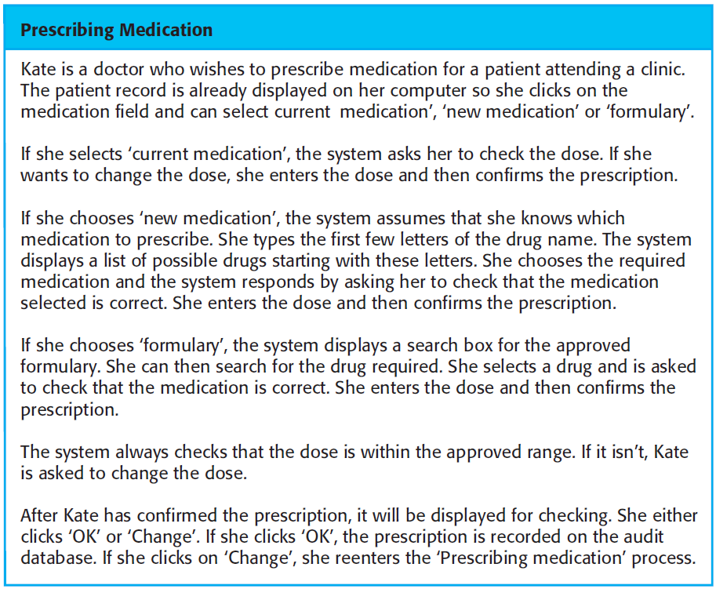
Example: A ‘prescribing medication’ story

Slide 76
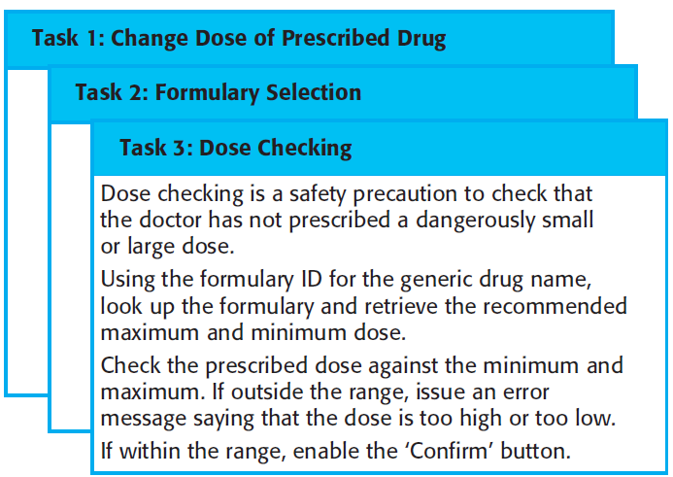
Examples of task cards for prescribing medication

Slide 77
Key points
Agile methods are incremental development methods that focus on rapid development, frequent releases of the software, reducing process overheads and producing high-quality code. They involve the customer directly in the development process.
The decision on whether to use an agile or a plan-driven approach to development should depend on the type of software being developed, the capabilities of the development team and the culture of the company developing the system.
Extreme programming is a well-known agile method that integrates a range of good programming practices such as frequent releases of the software, continuous software improvement and customer participation in the development team.

Slide 78
Testing in XP
Testing is central to XP and XP has developed an approach where the program is tested after every change has been made.
XP testing features:
Test-first development.
Incremental test development from scenarios.
User involvement in test development and validation.
Automated test harnesses are used to run all component tests each time that a new release is built.

Slide 79
Test-first development
Writing tests before code clarifies the requirements to be implemented.
Tests are written as programs rather than data so that they can be executed automatically. The test includes a check that it has executed correctly.
Usually relies on a testing framework such as Junit.
All previous and new tests are run automatically when new functionality is added, thus checking that the new functionality has not introduced errors.

Slide 80
Customer involvement
The role of the customer in the testing process is to help develop acceptance tests for the stories that are to be implemented in the next release of the system.
The customer who is part of the team writes tests as development proceeds. All new code is therefore validated to ensure that it is what the customer needs.
However, people adopting the customer role have limited time available and so cannot work full-time with the development team. They may feel that providing the requirements was enough of a contribution and so may be reluctant to get involved in the testing process.

Slide 81
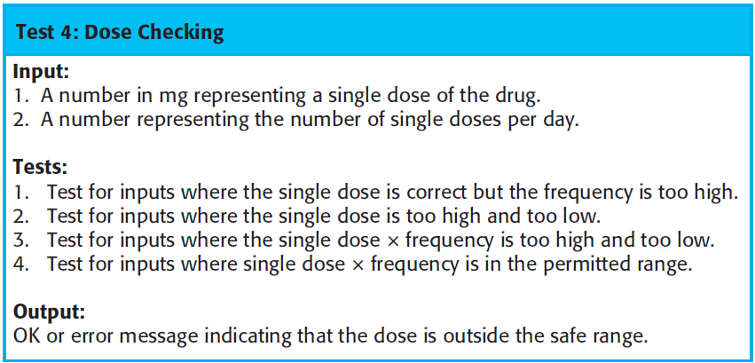
Test case description for dose checking

Slide 82
Test automation
Test automation means that tests are written as executable components before the task is implemented
These testing components should be stand-alone, should simulate the submission of input to be tested and should check that the result meets the output specification. An automated test framework (e.g. Junit) is a system that makes it easy to write executable tests and submit a set of tests for execution.
As testing is automated, there is always a set of tests that can be quickly and easily executed
Whenever any functionality is added to the system, the tests can be run and problems that the new code has introduced can be caught immediately.

Slide 83
XP testing difficulties
Programmers prefer programming to testing and sometimes they take short cuts when writing tests. For example, they may write incomplete tests that do not check for all possible exceptions that may occur.
Some tests can be very difficult to write incrementally. For example, in a complex user interface, it is often difficult to write unit tests for the code that implements the ‘display logic’ and workflow between screens.
It difficult to judge the completeness of a set of tests. Although you may have a lot of system tests, your test set may not provide complete coverage.

Slide 84
Pair programming
In XP, programmers work in pairs, sitting together to develop code.
This helps develop common ownership of code and spreads knowledge across the team.
It serves as an informal review process as each line of code is looked at by more than 1 person.
It encourages refactoring as the whole team can benefit from this.
Measurements suggest that development productivity with pair programming is similar to that of two people working independently.

Slide 85
Pair programming
In pair programming, programmers sit together at the same workstation to develop the software.
Pairs are created dynamically so that all team members work with each other during the development process.
The sharing of knowledge that happens during pair programming is very important as it reduces the overall risks to a project when team members leave.
Pair programming is not necessarily inefficient and there is evidence that a pair working together is more efficient than 2 programmers working separately.

Slide 86
Advantages of pair programming
It supports the idea of collective ownership and responsibility for the system.
Individuals are not held responsible for problems with the code. Instead, the team has collective responsibility for resolving these problems.
It acts as an informal review process because each line of code is looked at by at least two people.
It helps support refactoring, which is a process of software improvement.
Where pair programming and collective ownership are used, others benefit immediately from the refactoring so they are likely to support the process.

Slide 87
Scaling agile methods
Agile methods have proved to be successful for small and medium sized projects that can be developed by a small co-located team.
It is sometimes argued that the success of these methods comes because of improved communications which is possible when everyone is working together.
Scaling up agile methods involves changing these to cope with larger, longer projects where there are multiple development teams, perhaps working in different locations.

Slide 88
Large systems development
Large systems are usually collections of separate, communicating systems, where separate teams develop each system. Frequently, these teams are working in different places, sometimes in different time zones.
Large systems are ‘brownfield systems’, that is they include and interact with a number of existing systems. Many of the system requirements are concerned with this interaction and so don’t really lend themselves to flexibility and incremental development.
Where several systems are integrated to create a system, a significant fraction of the development is concerned with system configuration rather than original code development.

Slide 89
Large system development
Large systems and their development processes are often constrained by external rules and regulations limiting the way that they can be developed.
Large systems have a long procurement and development time. It is difficult to maintain coherent teams who know about the system over that period as, inevitably, people move on to other jobs and projects.
Large systems usually have a diverse set of stakeholders. It is practically impossible to involve all of these different stakeholders in the development process.

Slide 90
Scaling out and scaling up
‘Scaling up’ is concerned with using agile methods for developing large software systems that cannot be developed by a small team.
‘Scaling out’ is concerned with how agile methods can be introduced across a large organization with many years of software development experience.
When scaling agile methods it is essential to maintain agile fundamentals
Flexible planning, frequent system releases, continuous integration, test-driven development and good team communications.

Slide 91
Scaling up to large systems
For large systems development, it is not possible to focus only on the code of the system. You need to do more up-front design and system documentation
Cross-team communication mechanisms have to be designed and used. This should involve regular phone and video conferences between team members and frequent, short electronic meetings where teams update each other on progress.
Continuous integration, where the whole system is built every time any developer checks in a change, is practically impossible. However, it is essential to maintain frequent system builds and regular releases of the system.

Slide 92
Scaling out to large companies
Project managers who do not have experience of agile methods may be reluctant to accept the risk of a new approach.
Large organizations often have quality procedures and standards that all projects are expected to follow and, because of their bureaucratic nature, these are likely to be incompatible with agile methods.
Agile methods seem to work best when team members have a relatively high skill level. However, within large organizations, there are likely to be a wide range of skills and abilities.
There may be cultural resistance to agile methods, especially in those organizations that have a long history of using conventional systems engineering processes.

Slide 93
Key points
A particular strength of extreme programming is the development of automated tests before a program feature is created. All tests must successfully execute when an increment is integrated into a system.
The Scrum method is an agile method that provides a project management framework. It is centred round a set of sprints, which are fixed time periods when a system increment is developed.
Scaling agile methods for large systems is difficult. Large systems need up-front design and some documentation.

